Slide 1
World Development Measurement
PROJECT TITLE: “World Development Measurement”
MENTOR NAME: Ms. Snehal Shinde
GROUP NO.: 4
START DATE: 6 Nov 2023

Slide 2
Group details
Mr. Chintha Gangadhara | chinthagangadhara1@gmail.com | 8688620739
Mrs. Swapna Akella | swapna126491@gmail.com | 8008994791
Mr. Nikhil Gowda K | nikhilgowda736@gmail.com | 8073285770
MR. SRIHARSHA NOORBHASHA | sriharsha.nsh02@gmail.com | 9959905437
MR. Rohan Vasant Thorat | rohant1019@gmail.com | 8793574733
Mr. Akshay haridas rautray | akshayrautray6@gmail.com | 9637637670
Mrs. JONNADA BINDU | bindujonnada@gmail.com | 9505539842

Slide 3
Business Objective:
Creating clusters on the global development measurement dataset
The dataset has information about important economic and development metrics related to various countries across the globe.

Slide 4
Business Problem
To develop a cluster model for the world development measurement
Evaluate the performance of the model
Since the goal is to do a cluster analysis, this is a cluster analysis problem. The goal of clustering is to find distinct groups or “clusters” within a data set.

Slide 5
Project Architecture / Project Flow
Understanding the Business Problem
Dataset Understanding
EDA process
Feature Engineering
Model Building
Model Evaluation and Feedback
Deployment

Slide 6
Data Set Details:
The data file contains 2708 observations with 25 variables and has information about important economic and development metrics related to various countries across the globe.
The variables, or features, are the following:
Birth Rate, Business tax, CO2emissions, Country, Days to start a business, Ease of business, energy usage, GDP, healthexp%GDP, healthexp/capita, hours to do tax, infant mortality, internet usage, lending rate, life expectancy female, etc.

Slide 7
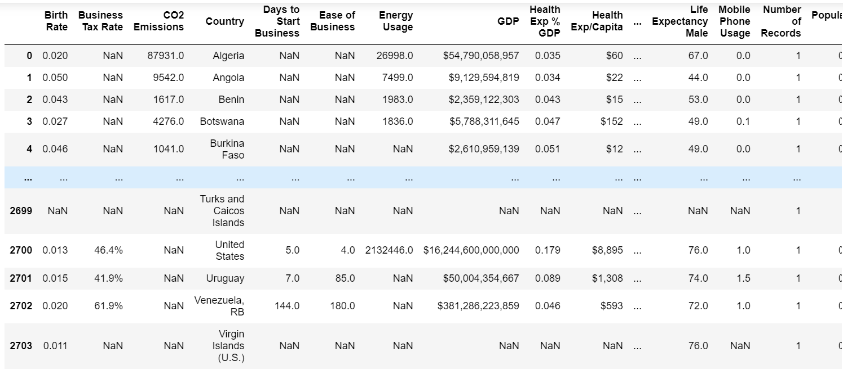
Data Set

Slide 8
Exploratory Data Analysis (EDA) and Feature Engineering

Slide 9
In the given dataset the datatype of the observations in each variable are floating point datatypes.
In the data set each feature contains null values.
There are no duplicate observations present in the dataset.
There are a total of 12203 null values present in the dataset.

Slide 10
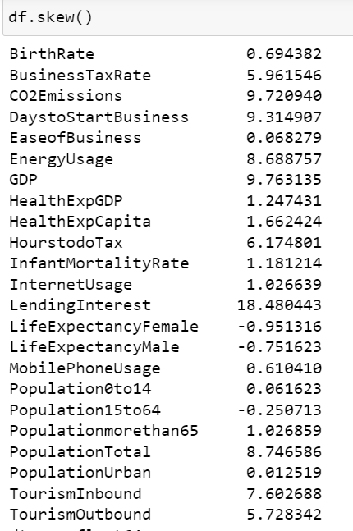
Data Distribution:
skewness

Slide 11
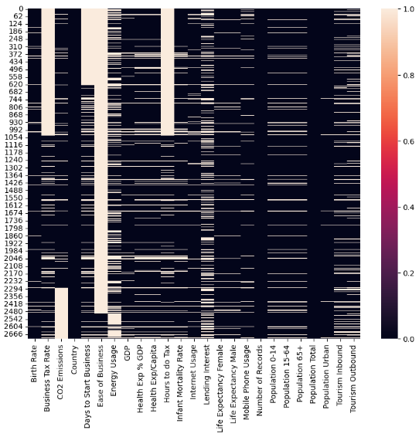
Visualizing the null values for each attribute with SNS Heatmap.
Ease of business contains more number of missing values
Population urban having less number of missing values.
There are no missing values in country and population total.

Slide 12
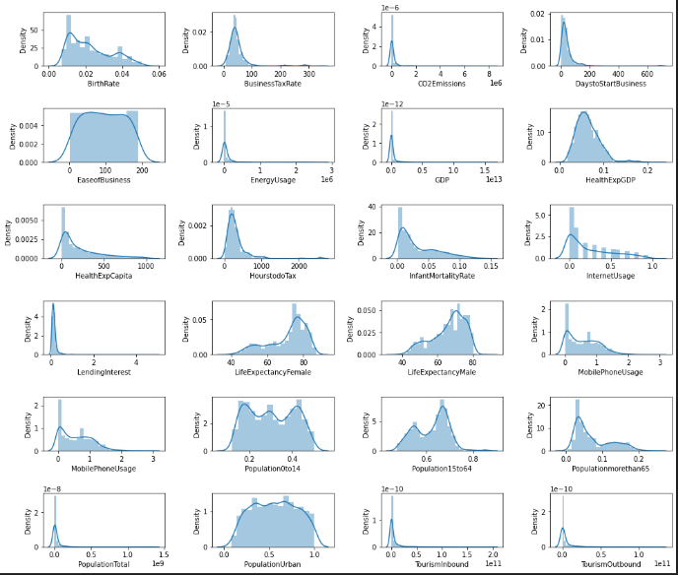
VISUALIZATION
Distribution plots for each column
'BusinessTaxRate', 'EaseofBusiness', 'HealthExpGDP', 'HourstodoTax' and 'Population0to14' columns have normal distribution so we replace missing values by mean.
And for remaining columns with skewed data we replace missing values by median.

Slide 13
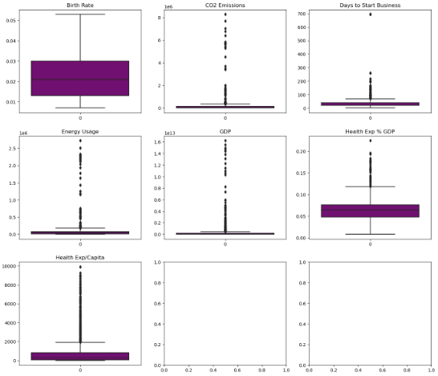
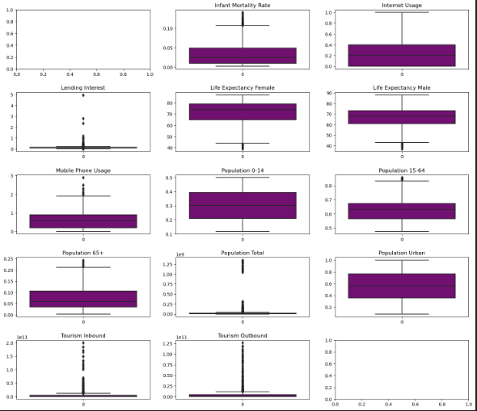
OUTLIER DETECTION
Some columns like "Population Total", "Tourism in bound", "Tourism out bound" has large number of outlier present.
columns like "Population Urban", "Population 0 to 14" has less number of outliers.

Slide 14
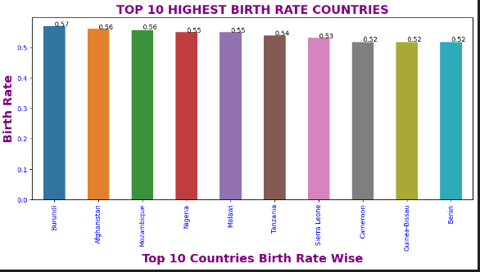
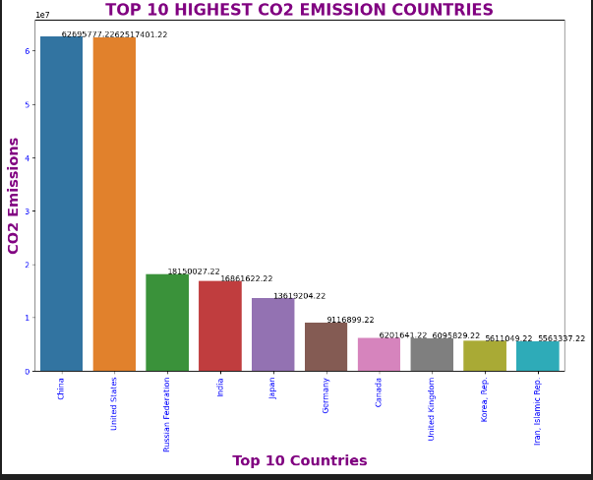
TOP 10 CO2 EMISSION COUNTRIES
China and the United States highest CO2 emission countries.
The Russian Federation, India, and Japan are medium CO2 emission countries.
Germany, Canada, UK, Korea, Iran Lowest CO2 emission Countries.
TOP 10 HIGHEST BIRTH RATE COUNTRIES

Slide 15
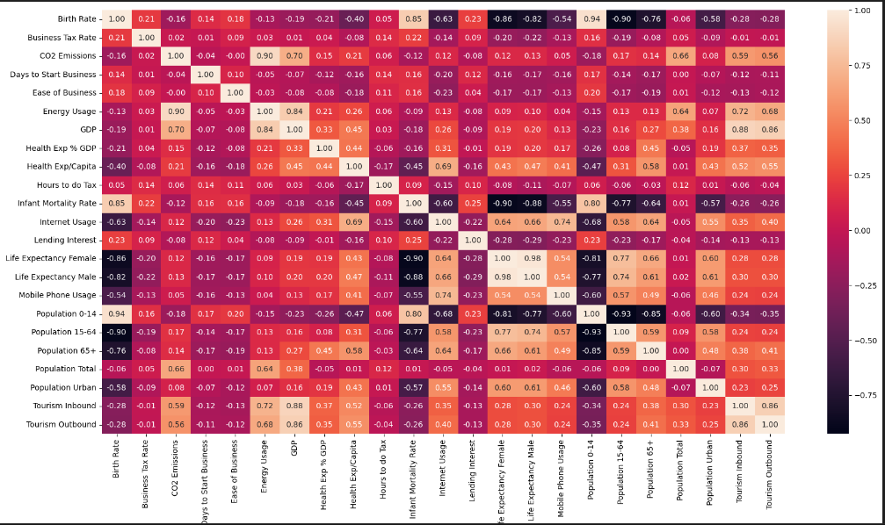
Visualizing Relation between variables
'Population 0 to 14' and 'Birth Rate’ have a strong relation. (0.94)
‘ Population 15 to 64’ and ‘Birth Rate’ have a weak relation. (0.90)

Slide 16
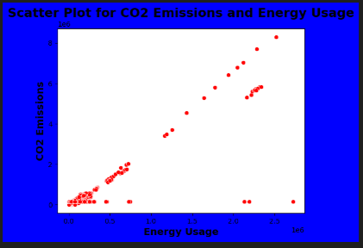
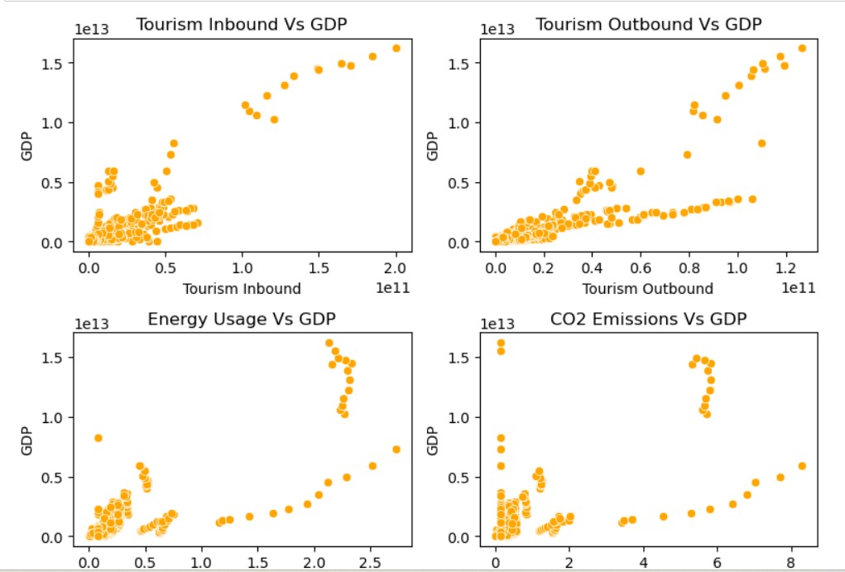
Scatter plot for CO2 emissions and energy usage
Scatter plots for GDP-related sources

Slide 17
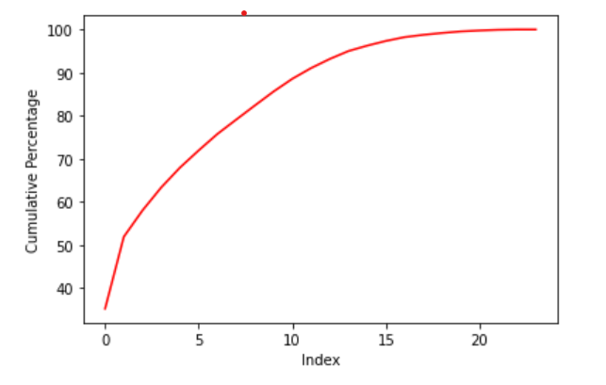
SCALING
Scaling is a technique to standardize the independent features present in the data in a fixed range. We do this to make sure all the features are in same scale
Here we will be using Standard Scaler
Feature Engineering
PCA Technique :
Looking at the graph we can decide how much percentage we want and accordingly go for that much column numbers.
here, we are taking 15 columns because they are giving more than 95% data.

Slide 18
Model Building

Slide 19
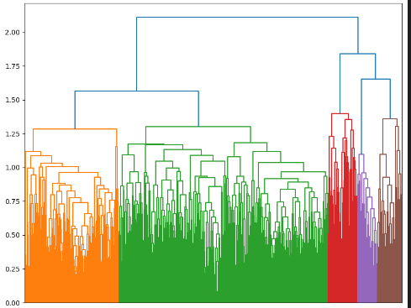
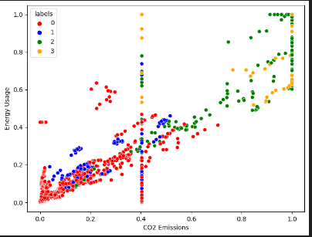
Hierarchical Clustering with scaled data
Visualized with Dendrogram and Scatter plot
Calculated silhouette score for labels.
Scaled Data got a silhouette score - 0.4069002367119094

Slide 20
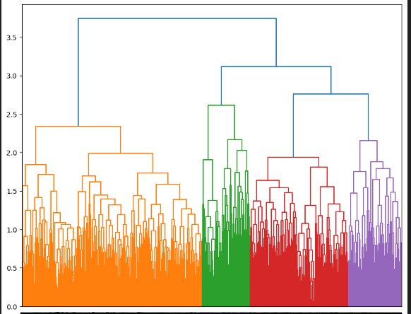
Hierarchical Clustering with complete linkage
Calculated silhouette score for complete linkage.
Scaled Data got a silhouette score - 0.44947005579625016

Slide 21
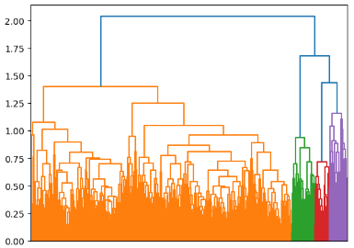
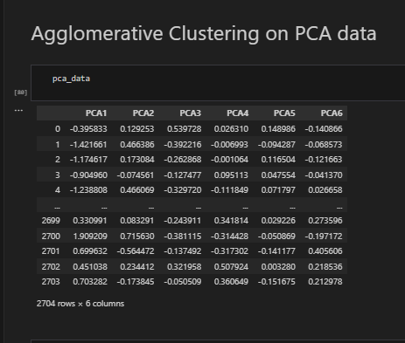
Agglomerative Clustering on PCA data
Calculated silhouette score for agglomerative clustering on PCA data.
agglomerative clustering on PCA data got a silhouette score - 0.4892175454522696

Slide 22
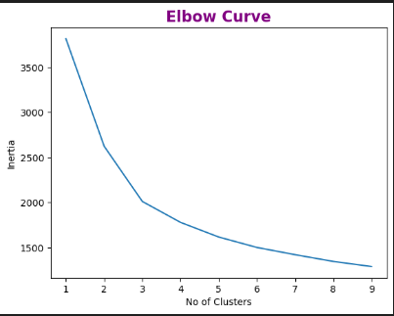
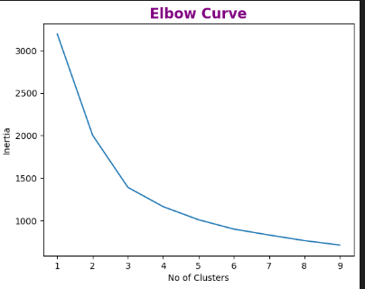
K-Means clustering on PCA Data
By seeing above elbow curve considering 3 clusters.
K Means with 4 Clusters we got silhouette score - 0.38589504828738286
K Means with Clusters we got silhouette score -0.4592576382823015
K-Means with PCA Data – 3 clusters
By seeing the above elbow curve considering 3 clusters.
K Means with PCA Data - 2 Clusters we got silhouette score -0.4349454775483713
K Means with PCA data - 4Clusters we got silhouette score -0.3016847742272087

Slide 23
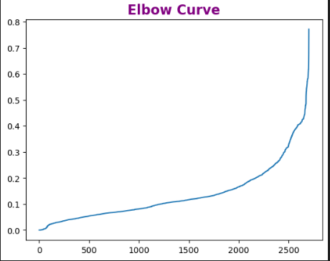
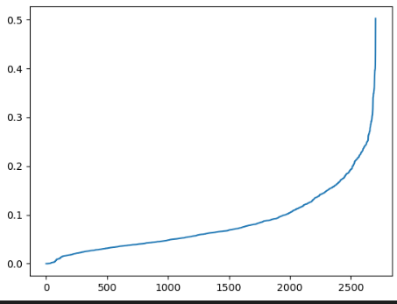
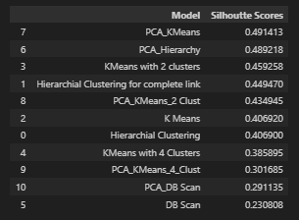
DBSCAN Using Original Data
Calculated distance by using the nearest neighbors method.
DBSCAN with Original Data - we got silhouette score -0.230808
DBSCAN with PCA Data - we got silhouette score -0.291135

Slide 24
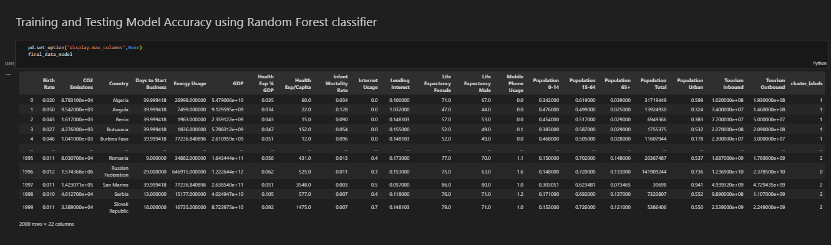
Training and Testing Model accuracy using random forest classifier
We got accuracy – 0.96

Slide 25
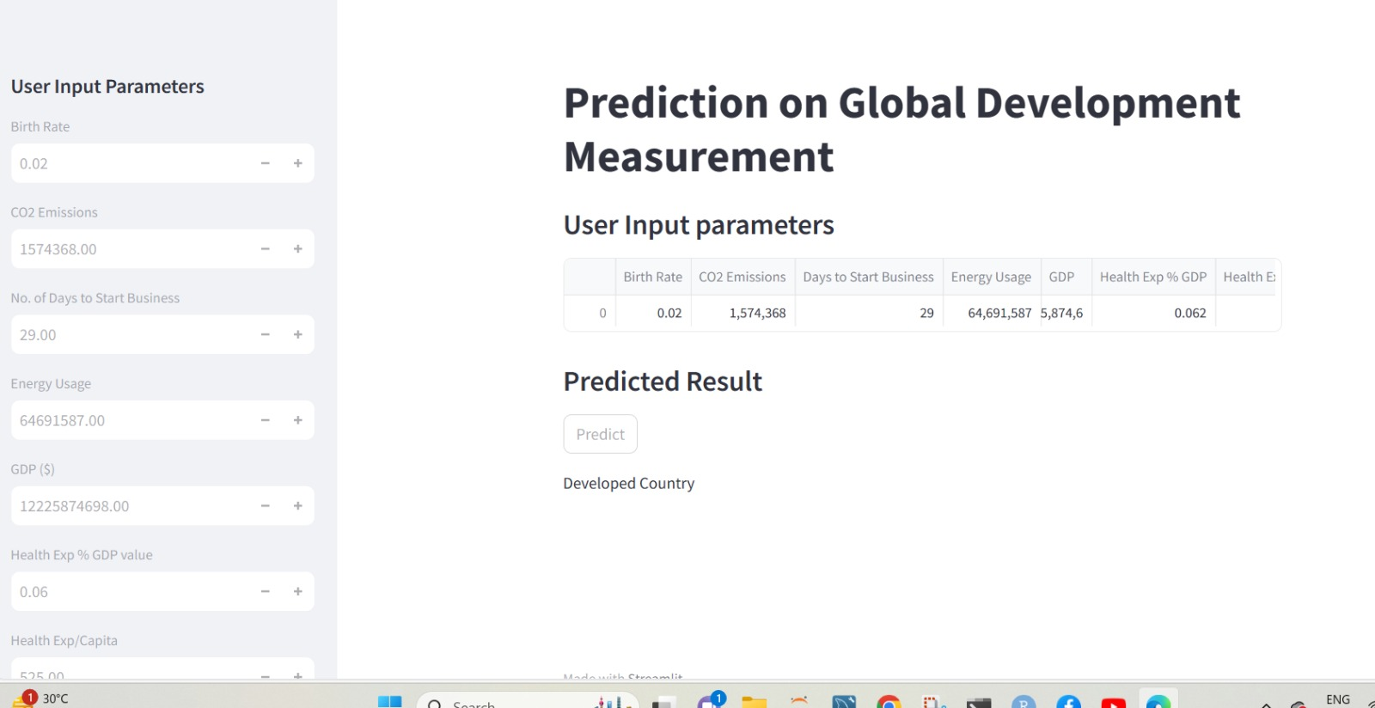
Deployment Model
Developed country

Slide 26
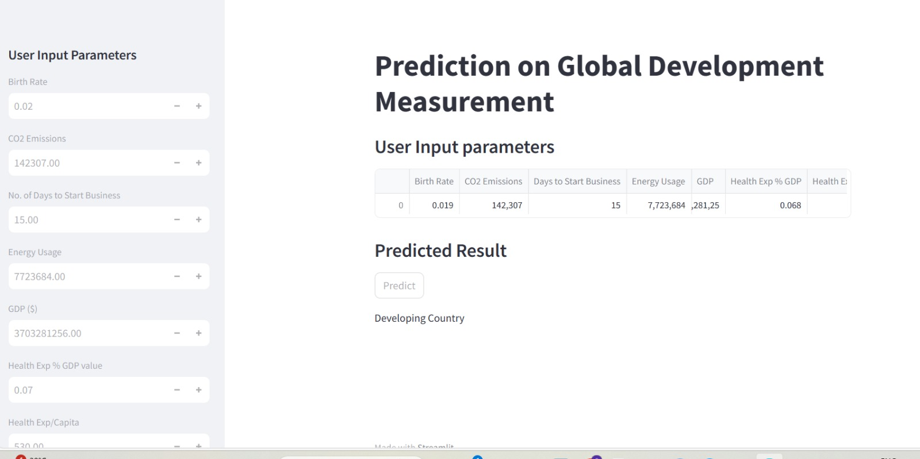
Developing Country

Slide 27
References
1.https://pandas.pydata.org/
2.https://numpy.org/doc/
3.https://matplotlib.org/
4.https://seaborn.pydata.org/
5.https://scikit-learn.org/
6.https://www.statsmodels.org/

Slide 28
Thank You

